Slide 1
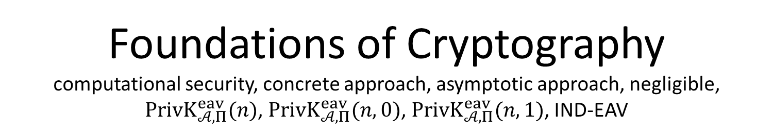
Foundations of Cryptography computational security, concrete approach, asymptotic approach, negligible, $PrivK_{𝒜, Π}^{eav}(n)$, $PrivK_{𝒜, Π}^{eav}(n,0)$, $PrivK_{𝒜, Π}^{eav}(n,1)$, IND-EAV
LiangFeng Zhang
zhanglf@shanghaitech.edu.cn

Slide 2
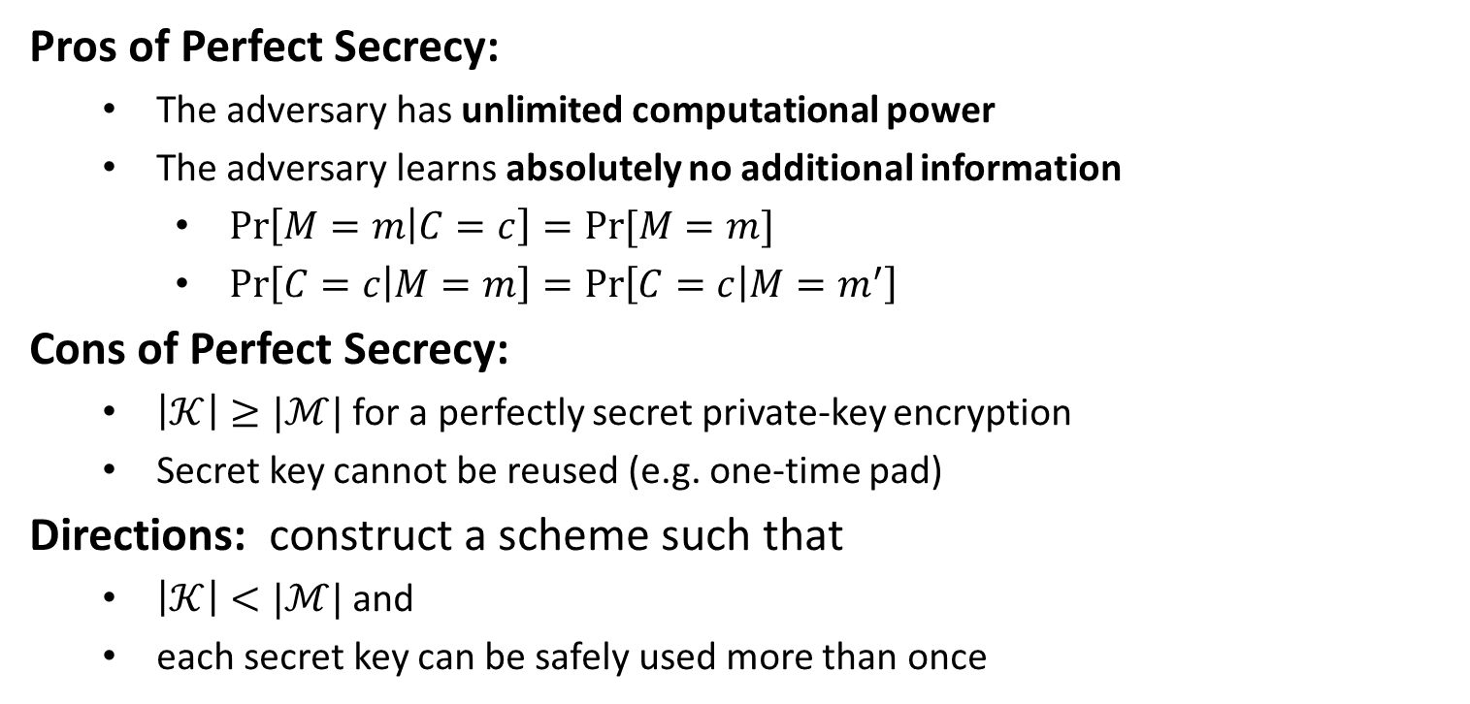
Pros and Cons
Pros of Perfect Secrecy:
The adversary has unlimited computational power
The adversary learns absolutely no additional information
$\operatorname{Pr}\left[M=m | C=c\right]=Pr⁡[M=m]$
$\operatorname{Pr}\left[C=c | M=m\right]=\operatorname{Pr}\left[C=c | M=m^{′}\right]$
Cons of Perfect Secrecy:
$\left|𝒦\right|≥|ℳ|$ for a perfectly secret private-key encryption
Secret key cannot be reused (e.g. one-time pad)
Directions: construct a scheme such that
$\left|𝒦\right|<|ℳ|$ and
each secret key can be safely used more than once

Slide 3
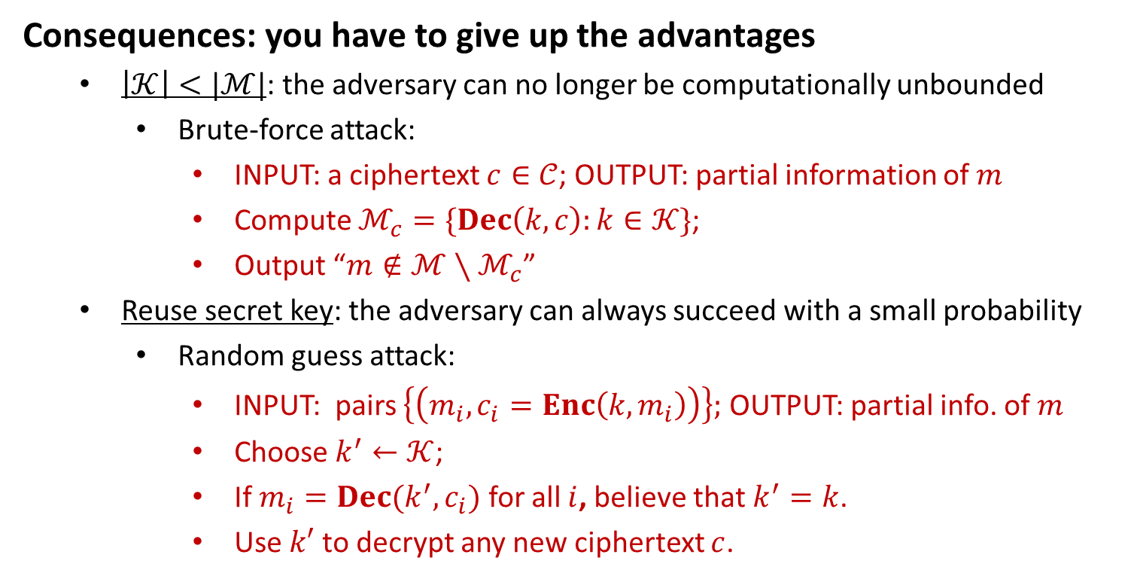
Bypass Impossibility
Consequences: you have to give up the advantages
$\left|𝒦\right|<|ℳ|$: the adversary can no longer be computationally unbounded
Brute-force attack:
INPUT: a ciphertext $c∈𝒞$; OUTPUT: partial information of $m$
Compute $ℳ_{c}=\{Dec\left(k,c\right):k∈𝒦\}$;
Output “$m∉ℳ∖ℳ_{c}$”
Reuse secret key: the adversary can always succeed with a small probability
Random guess attack:
INPUT: pairs $\left\{\left(m_{i},c_{i}=Enc\left(k,m_{i}\right)\right)\right\};$ OUTPUT: partial info. of $m$
Choose $k^{′}←𝒦$;
If $m_{i}=Dec(k^{′},c_{i})$ for all $i$, believe that $k^{′}=k$.
Use $k′$ to decrypt any new ciphertext $c$.

Slide 4
Bypass Impossibility
Compromise: relax the security definition of perfect secrecy
The adversary’s computational power should be bounded
The adversary is allowed to break the scheme with a very small probability
Computational Security (Idea): a private-key encryption is secure if
The adversary is computationally bounded (efficient) and runs for some feasible amount of time
The adversary can potentially succeed with very small probability
Principle of Computational Security:
Kerckhoff: A cipher must be practically, if not mathematically, indecipherable
How to Define Computational Security?
Concrete Approach
Asymptotic Approach

Slide 5
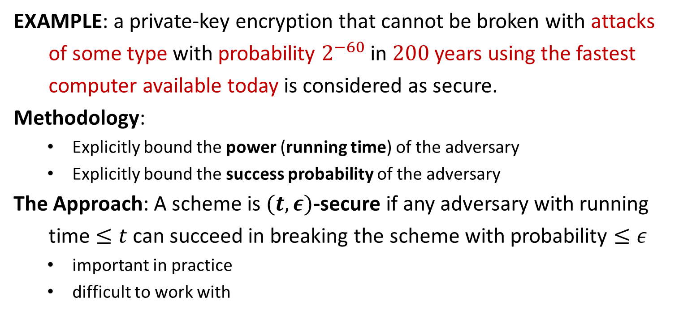
Concrete Approach
EXAMPLE: a private-key encryption that cannot be broken with attacks
of some type with probability $2^{−60}$ in $200$ years using the fastest
computer available today is considered as secure.
Methodology:
Explicitly bound the power (running time) of the adversary
Explicitly bound the success probability of the adversary
The Approach: A scheme is $(t,ε)$-secure if any adversary with running
time $≤t$ can succeed in breaking the scheme with probability $≤ε$
important in practice
difficult to work with

Slide 6
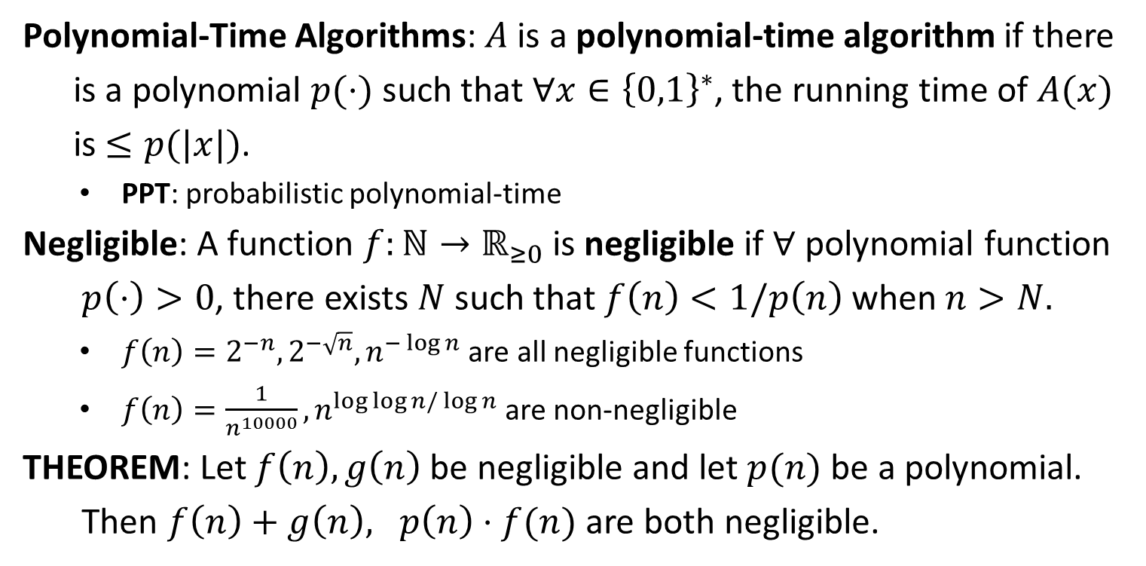
PPT and Negligible
Polynomial-Time Algorithms: $A$ is a polynomial-time algorithm if there
is a polynomial $p(⋅)$ such that $∀x∈{\left\{0,1\right\}}^{∗}$, the running time of $A(x)$
is $≤p(|x|)$.
PPT: probabilistic polynomial-time
Negligible: A function $f:ℕ→ℝ_{≥0}$ is negligible if $∀$ polynomial function
$p\left(⋅\right)>0$, there exists $N$ such that $f\left(n\right)<1/p\left(n\right)$ when $n>N.$
$f\left(n\right)=2^{−n}, 2^{−\sqrt{n}}, n^{−\log{n}}$ are all negligible functions
$f\left(n\right)=\frac{1}{n^{10000}}, n^{\log{\log{n}/\log{n}}}$are non-negligible
THEOREM: Let $f\left(n\right), g\left(n\right)$ be negligible and let $p(n)$ be a polynomial.
Then $f\left(n\right)+g\left(n\right), p\left(n\right)⋅f(n)$ are both negligible.

Slide 7
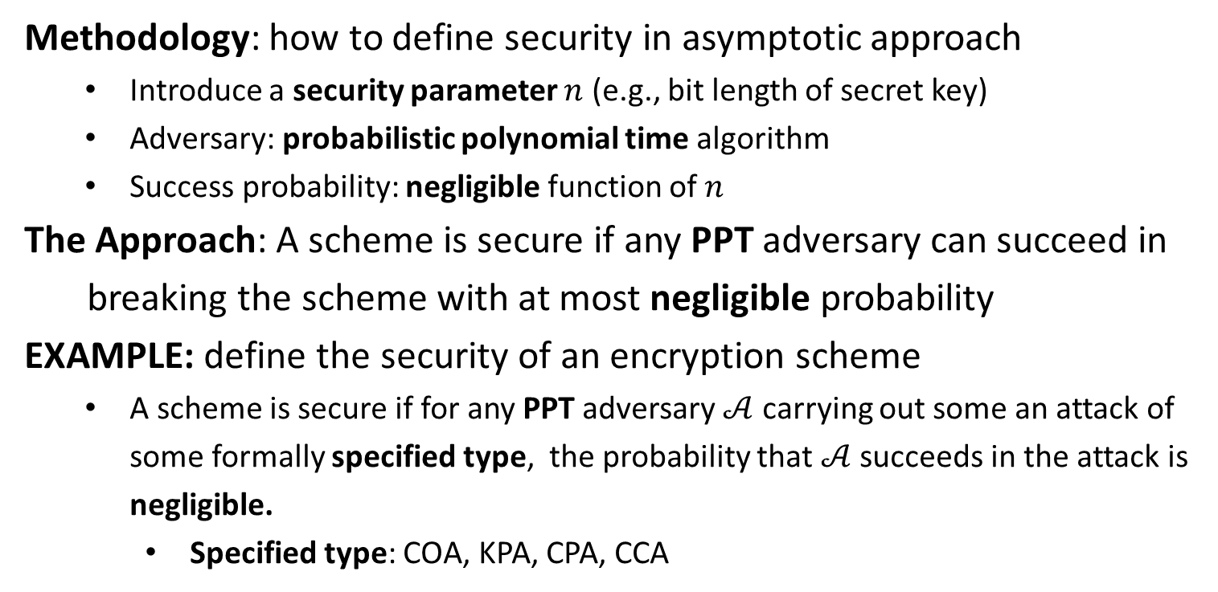
Asymptotic Approach
Methodology: how to define security in asymptotic approach
Introduce a security parameter $n$ (e.g., bit length of secret key)
Adversary: probabilistic polynomial time algorithm
Success probability: negligible function of $n$
The Approach: A scheme is secure if any PPT adversary can succeed in
breaking the scheme with at most negligible probability
EXAMPLE: define the security of an encryption scheme
A scheme is secure if for any PPT adversary $𝒜$ carrying out some an attack of some formally specified type, the probability that $𝒜$ succeeds in the attack is negligible.
Specified type: COA, KPA, CPA, CCA

Slide 9







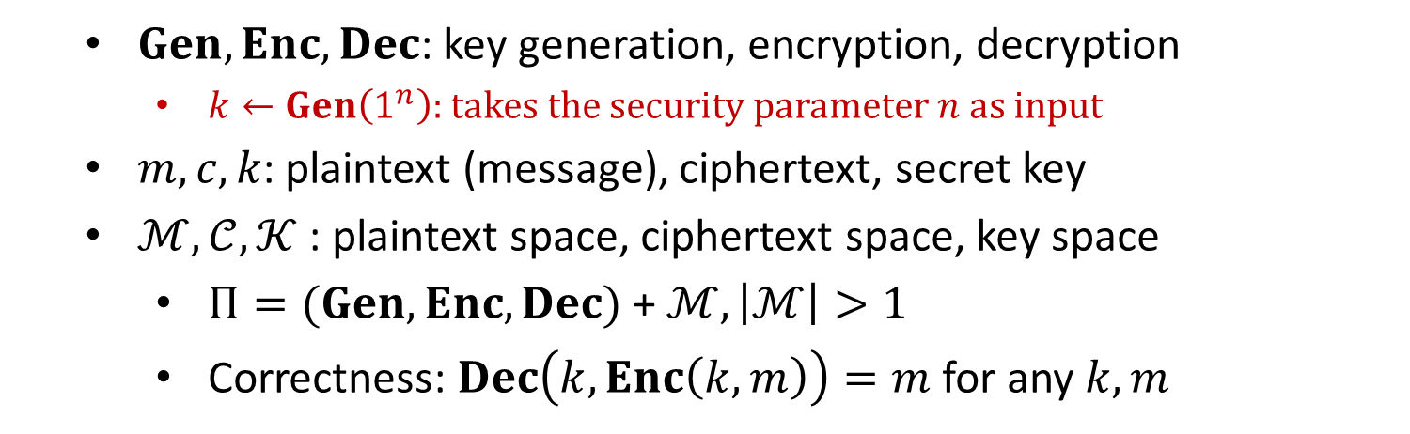



Private-Key Encryption
$$m$$
$$Enc$$
$$c←Enc(k, m)$$
$$Dec$$
Alice
Bob
$$k$$
$$k$$
$$Dec(k, c)=m$$
$$Gen$$
$Gen, Enc, Dec$: key generation, encryption, decryption
$k←Gen\left(1^{n}\right):$ takes the security parameter $n$ as input
$m, c, k$: plaintext (message), ciphertext, secret key
$ℳ,𝒞, 𝒦$ : plaintext space, ciphertext space, key space
$Π=(Gen, Enc, Dec)$ + $ℳ, \left|ℳ\right|>1$
Correctness: $Dec\left(k,Enc\left(k,m\right)\right)=m$ for any $k,m$

Slide 10
Indistinguishability in the presence of an eavesdropper (IND-EAV)
Threat Model: the power of adversaries
computational power: probabilistic polynomial-time algorithms
actions: choose two plaintexts and observe one ciphertext
Security Guarantee: what is a break
Given the ciphertext, the adversary should be unable to learn any partial information of the plaintext
called semantic security (Goldwasser and Micali, 1985)
equivalent definition: indistinguishability (proved, ref. Goldreich)

Slide 11




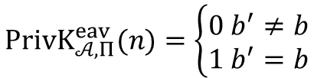


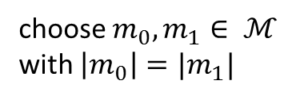

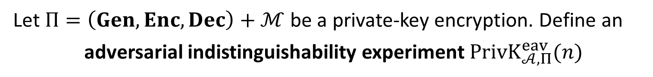


$$PrivK_{𝒜, Π}^{eav}(n)$$
Let $Π=\left(Gen, Enc, Dec\right)+ℳ$ be a private-key encryption. Define an
adversarial indistinguishability experiment $PrivK_{𝒜, Π}^{eav}(n)$
choose $m_{0}, m_{1}∈ ℳ$
with $\left|m_{0}\right|=|m_{1}|$
$$m_{0},m_{1}$$
$$k←Gen\left(1^{n}\right)$$
$$b←\{0,1\}$$
$$Challenger$$
$$c←Enc(k,m_{b})$$
$$Adversary 𝒜$$
$$c$$
$$b′$$
$$PrivK_{𝒜, Π}^{eav}(n)=\left\{\begin{aligned}0 b^{′}≠b \\ 1 b^{′}=b\end{aligned}\right.$$

Slide 12
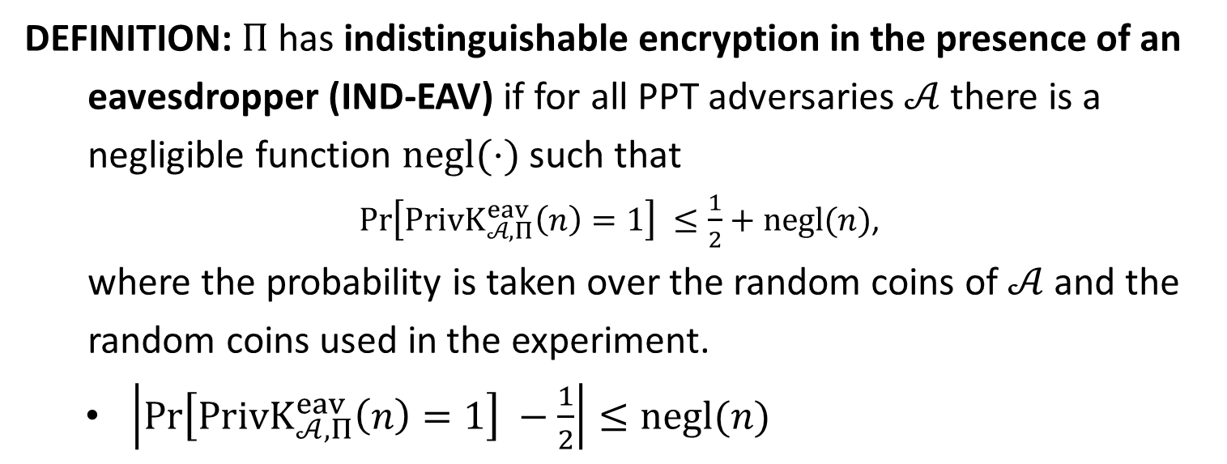
IND-EAV
DEFINITION: $Π$has indistinguishable encryption in the presence of an
eavesdropper (IND-EAV) if for all PPT adversaries $𝒜$ there is a
negligible function $negl(⋅)$ such that
$\operatorname{Pr}\left[PrivK_{𝒜, Π}^{eav}\left(n\right)=1\right] ≤\frac{1}{2}+negl(n)$,
where the probability is taken over the random coins of $𝒜$ and the
random coins used in the experiment.
$\left|\operatorname{Pr}\left[PrivK_{𝒜, Π}^{eav}\left(n\right)=1\right] −\frac{1}{2}\right|≤negl(n)$

Slide 13

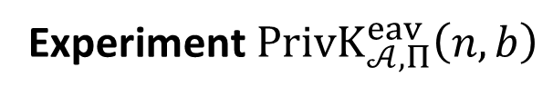





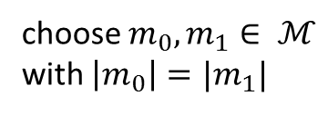



$$PrivK_{𝒜, Π}^{eav}\left(n,b\right)$$
Let $Π=\left(Gen, Enc, Dec\right)+ℳ$ be a private-key encryption.
Experiment $PrivK_{𝒜, Π}^{eav}\left(n,b\right)$
choose $m_{0}, m_{1}∈ ℳ$
with $\left|m_{0}\right|=|m_{1}|$
$$m_{0},m_{1}$$
$$k←Gen\left(1^{λ}\right)$$
$$Challenger$$
$$c←Enc(k,m_{b})$$
$$Adversary 𝒜$$
$$c$$
$$b^{′}$$
$$b^{′}={out}_{𝒜}(PrivK_{𝒜, Π}^{eav}\left(n,b\right))$$

Slide 14
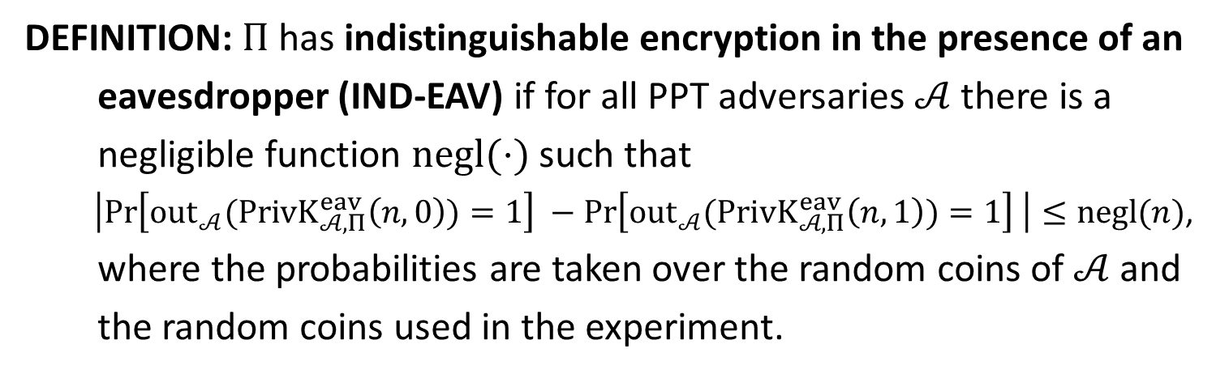
IND-EAV
DEFINITION: $Π$has indistinguishable encryption in the presence of an
eavesdropper (IND-EAV) if for all PPT adversaries $𝒜$ there is a
negligible function $negl(⋅)$ such that
$\left|\operatorname{Pr}\left[{out}_{𝒜}(PrivK_{𝒜, Π}^{eav}\left(n,0\right))=1\right] −\operatorname{Pr}\left[{out}_{𝒜}(PrivK_{𝒜, Π}^{eav}\left(n,1\right))=1\right] \right|≤negl(n)$,
where the probabilities are taken over the random coins of $𝒜$ and
the random coins used in the experiment.

